Slide 1


Group Project
Vaccine recording system

Slide 2
Team 5
Grigorios Ladas, grigorioslad@hotmail.com
Eleni Machremi, elmachremi@gmail.com
George Rouvas, rouvasgr@gmail.com
Ourania Zolota, rania_zolota@hotmail.com

Slide 3
Project Info & Management
The project Vaccine Recording System aims at developing an Application Programming Interface (API) to help an insured civilian get vaccinated. Through API calls an insured civilian can make a reservation, edit a reservation and get informed for his vaccination status. Furthermore, the doctor has the ability to register a vaccination.

Slide 4
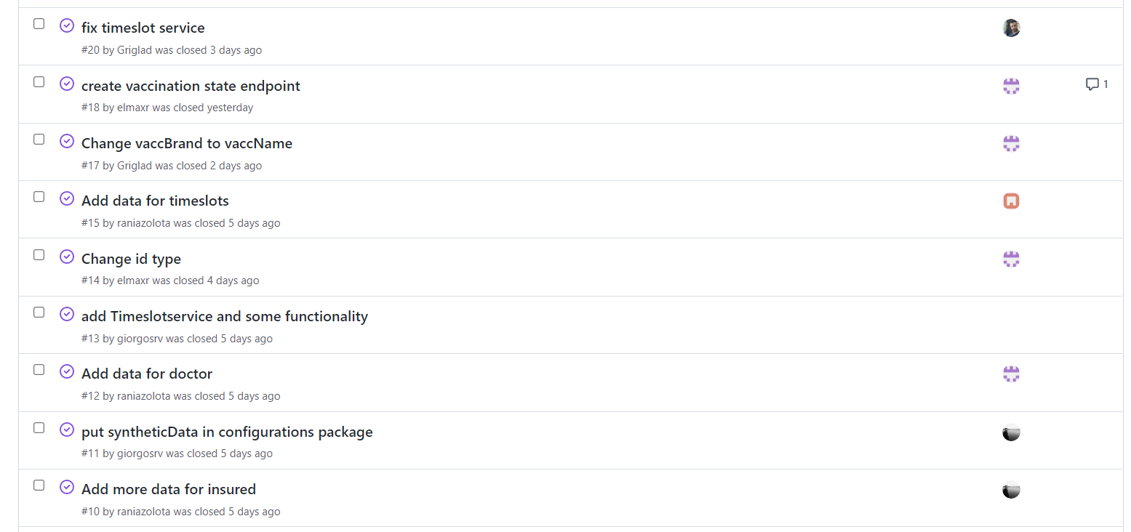
Git Issues

Slide 5
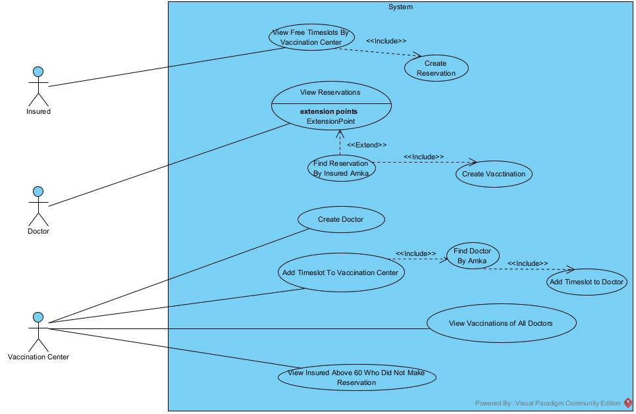
Use Cases
photo

Slide 6
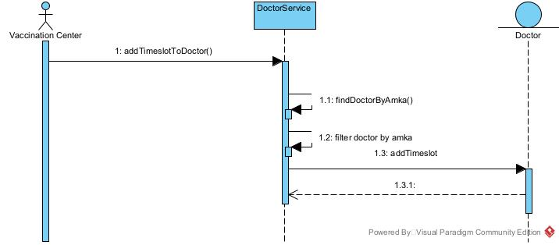
Sequence Diagram
Sequence Diagram for Use Case “Add Timeslot to Doctor”
photo

Slide 7
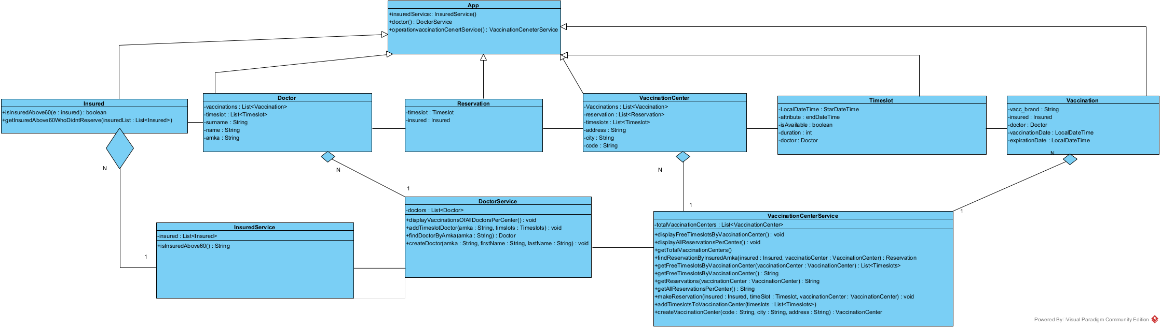
UML Class Diagram

Slide 8
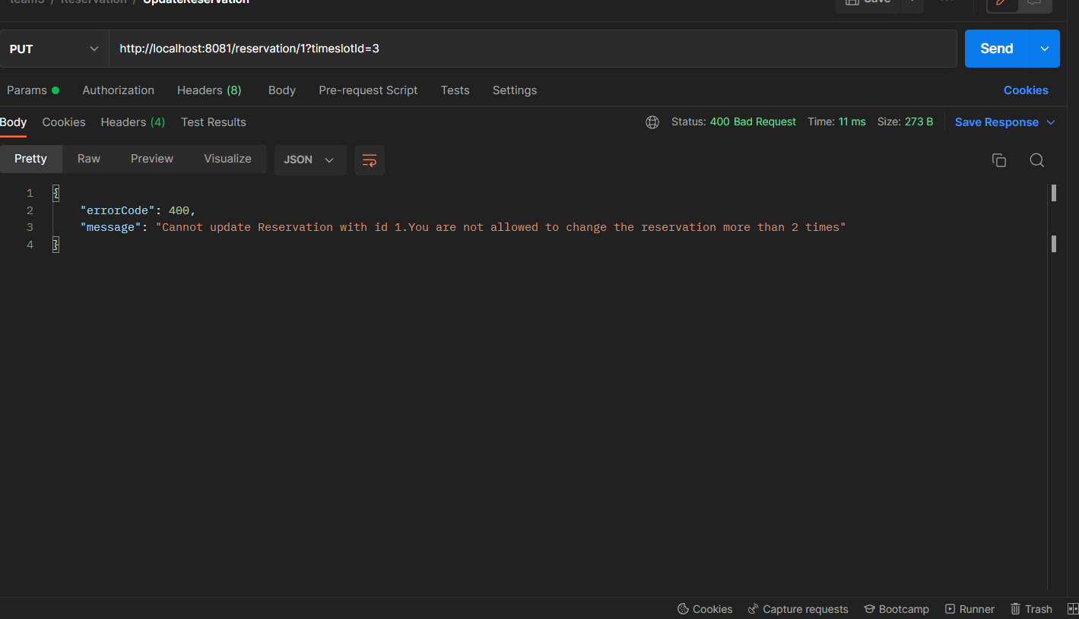
API Requests

Slide 9
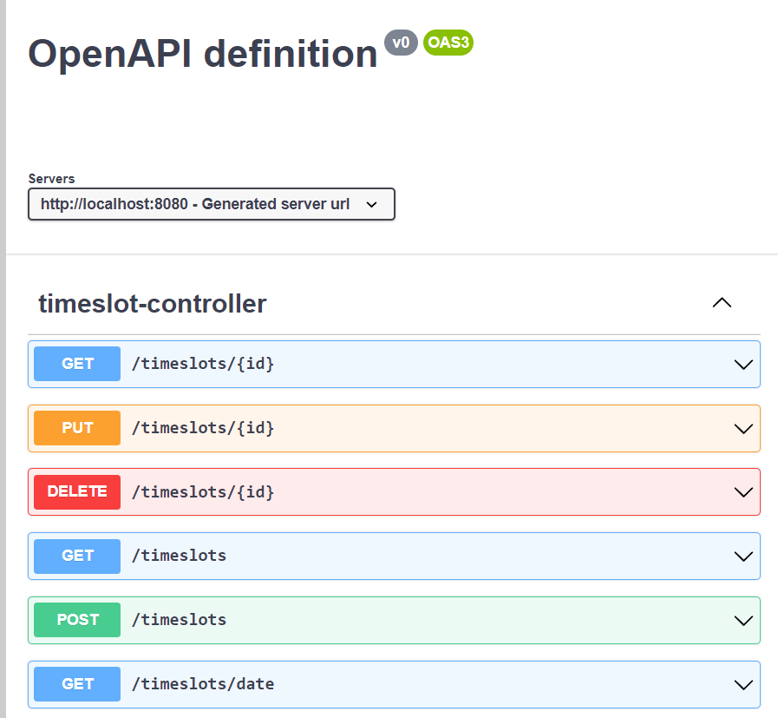
Service Documentation
http://localhost:8080/api
http://localhost:8080/swagger-ui/index.html

Slide 10
Thank you!

